Slide 1
Lab 2: Buttons and LEDs
ECE 0202

Slide 2
Lab Outline
Download C template project from canvas
Enable peripheral clocks for buttons and LEDs
Set configuration registers for buttons and LEDS
Write a loop that does: if button is pressed → then turn on LED’s
Show us the project on your board (checkoff)
Manually toggle LED in debug mode (checkoff)
Submit code and pre lab answers on canvas

Slide 3
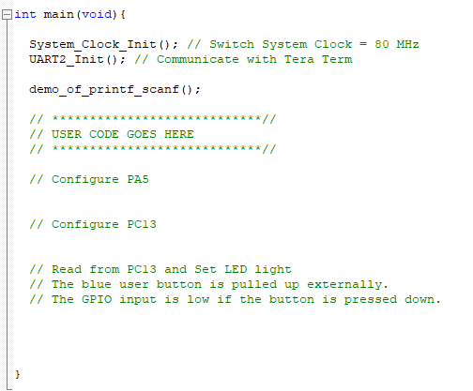
Download C template
Only code you should change

Slide 4

2. Configuring Clock
RCC->AHB2ENR |= RCC_AHB2ENR_GPIOBEN; Reset and Clock Control (RCC)
A number defined in stm32l476xx.h that gives the mask to enable port B’s clock
Struct defined in stm32l476xx.h,
stands for “Reset and Clock Control”
Register found in this module
Stands for: “Advanced High-Performance Bus 2 Enable Register”

Slide 5
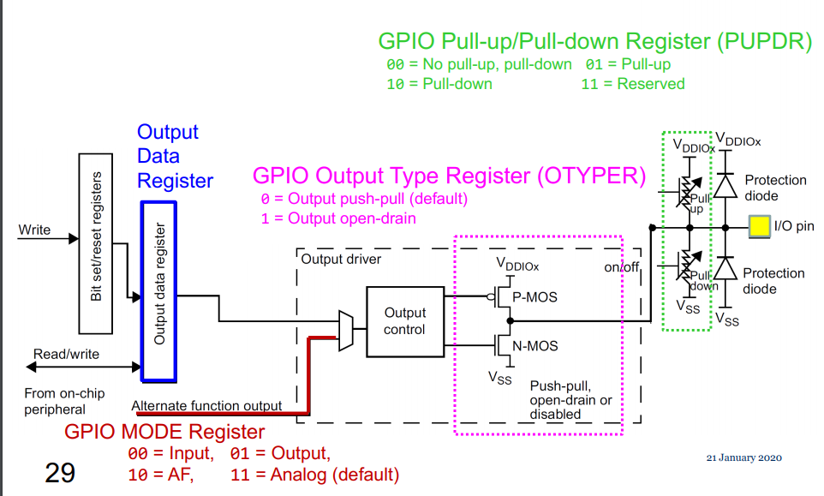
3. Configuring Peripherals: LED
GPIOA->...your specific config register
Pre lab and lecture notes are very helpful

Slide 6
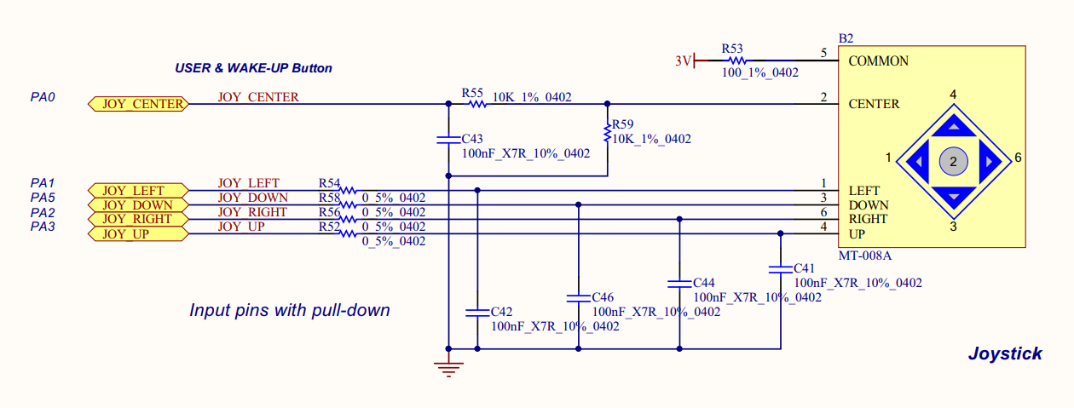
3. Configuring Peripherals: Buttons
GPIOC->...your specific config register
Will need to set your mode (MODER), resistors (PUPDR), and read from the input register (IDR)

Slide 7
Setting a Bit
Example: GPIOA->ODR |= 1UL<<3;
15 | 14 | 13 | 12 | 11 | 10 | 9 | 8 | 7 | 6 | 5 | 4 | 3 | 2 | 1 | 0
1UL
1UL<<3
x | x | x | x | x | x | x | x | x | x | x | x | x | x | x | x
X
x | x | x | x | x | x | x | x | x | x | x | x | 1 | x | x | x
X |= (1UL<<3)

Slide 8
Clearing a Bit
Example: GPIOA->ODR &= 0xFFCF
15 | 14 | 13 | 12 | 11 | 10 | 9 | 8 | 7 | 6 | 5 | 4 | 3 | 2 | 1 | 0
0xFFCF
x | x | x | x | x | x | x | x | x | x | x | x | x | x | x | x
X
x | x | x | x | x | x | x | x | x | x | 0 | 0 | x | x | x | x
X &= 0xFFCF

Slide 9
Clearing a Bit
Example: GPIOA->ODR &= ~(3UL<<4);
15 | 14 | 13 | 12 | 11 | 10 | 9 | 8 | 7 | 6 | 5 | 4 | 3 | 2 | 1 | 0
3UL
3UL<<4
~(3UL<<4)
x | x | x | x | x | x | x | x | x | x | 0 | 0 | x | x | x | x
X &= ~(3UL<<4)

Slide 10

Toggling a Bit
Example: GPIOA->ODR ^= (1UL<<2);
15 | 14 | 13 | 12 | 11 | 10 | 9 | 8 | 7 | 6 | 5 | 4 | 3 | 2 | 1 | 0
1UL
1UL<<2
x | x | x | x | x | x | x | x | x | x | x | x | x | 0 | x | x
X
x | x | x | x | x | x | x | x | x | x | x | x | x | 1 | x | x
X ^= (1UL<<2)
Caution: If done continuously, oscillation can occur

Slide 11
Reading from the IDR Register
I want to check bits 2 and 0
3 | 2 | 1 | 0
0 | 0 | 0 | 0
Int X = (Input Register & (0b0101))
X = 0b0000
Boolean ON = (X!=0)
ON=False

Slide 12
Reading from the IDR Register
I want to check bits 2 and 0
3 | 2 | 1 | 0
0 | 0 | 1 | 0
Int X = (Input Register & (0b0101))
X = 0b0000
Boolean ON = (X!=0)
ON=False

Slide 13
Reading from the IDR Register
I want to check bits 2 and 0
3 | 2 | 1 | 0
0 | 1 | 0 | 0
Int X = (Input Register & (0b0101))
X = 0b0100
Boolean ON = (X!=0)
ON=True

Slide 14
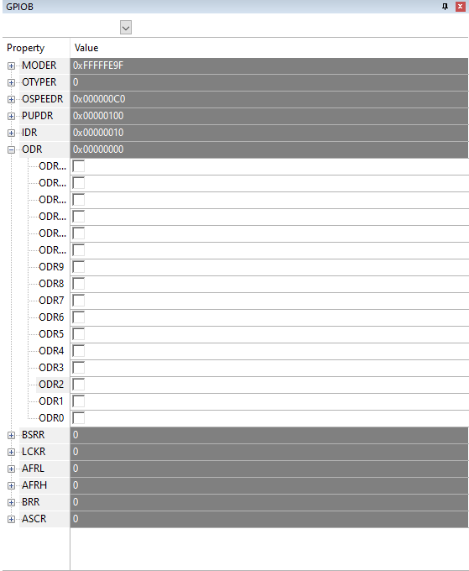
Viewing/Editing Peripherals in Keil
Turn on Debug mode
Peripheral menu→ system viewer → GPIO → GPIOX
Window opens up to view the registers (e.g. MODER, IDR. etc)

Slide 15

Coding Style & Submission Tips
It helps us if you submit your code as .c/.s files (i.e. “text”), please don’t send screenshots
Comments are necessary to get full credit (plus its a good habit to form now)

